Slide 1
NP-Complete problems

Slide 2
Run-time analysis
We’ve spent a lot of time in this class putting algorithms into specific run-time categories:
O(log n)
O(n)
O(n log n)
O(n²)
O(n log log n)
O(n^{1.67})
…
Polynomial time = in terms of n^{k} (where n is input size)
Notes:
Today, we’re going to look at broader categories

Slide 3

Tractable vs. intractable problems
What is a “tractable” problem?

Slide 4
Tractable vs. intractable problems
Tractable problems can be solved in a polynomial time and considered practically feasible

Slide 5
Tractable vs. intractable problems
Super polynomial time is any time which grows faster than polynomial
O(2^{n})
O(n!)
O(n^{n})
Intractable problems take super polynomial time and considered impractical and hard.

Slide 6
Generally, we think of problems that are solvable by
polynomial-time algorithms are being tractable, and problems that requires super polynomial time are being intractable.

Slide 7

Solvable vs. unsolvable problems
What is a “solvable” problem?

Slide 8
Solvable vs. unsolvable problems
A problem is solvable if given enough (i.e. finite) time you could solve it

Slide 9
Sorting
Given n integers, sort them from smallest to largest.
Tractable/intractable?
Solvable/unsolvable?

Slide 10
Sorting
Given n integers, sort them from smallest to largest.
Solvable and tractable:
Mergesort: Θ(n log n )

Slide 11
Enumerating all subsets
Given a set of n items, enumerate all possible subsets.
Tractable/intractable?
Solvable/unsolvable?

Slide 12
Enumerating all subsets
Given a set of n items, enumerate all possible subsets.
Solvable, but intractable: Θ(2^{n}) subsets
For large n this will take a very, very long time

Slide 13
Halting problem
Given an arbitrary algorithm/program and a particular input, will the program terminate?
Tractable/intractable?
Solvable/unsolvable?

Slide 14
Halting problem
Given an arbitrary algorithm/program and a particular input, will the program terminate?
Unsolvable ☹

Slide 15
Integer solution?
Given a polynomial equation, are there integer values of the variables such that the equation is true?
Tractable/intractable?
Solvable/unsolvable?

Slide 16
Integer solution?
Given a polynomial equation, are there integer values of the variables such that the equation is true?
Unsolvable ☹

Slide 17
Hamiltonian cycle
Given an undirected graph G=(V, E), a hamiltonian cycle is a cycle that visits every vertex V exactly once
A
B
F
D
E

Slide 18
Hamiltonian cycle
Given an undirected graph G=(V, E), a hamiltonian cycle is a cycle that visits every vertex V exactly once
A
B
F
D
E

Slide 19
Hamiltonian cycle
Given an undirected graph G=(V, E), a hamiltonian cycle is a cycle that visits every vertex V exactly once
A
B
F
D
E

Slide 20
Hamiltonian cycle
Given an undirected graph G=(V, E), a hamiltonian cycle is a cycle that visits every vertex V exactly once
A
B
F
D
E

Slide 21
Hamiltonian cycle
Given an undirected graph, does it contain a hamiltonian cycle?
Tractable/intractable?
Solvable/unsolvable?

Slide 22
Hamiltonian cycle
Given an undirected graph, does it contain a hamiltonian cycle?
Solvable: Enumerate all possible paths (i.e. include an edge or don’t) check if it’s a hamiltonian cycle

Slide 23
Classification of Problems

Slide 24
P and NP
Class P is a class of decision problems that can be solved in polynomial time by deterministic algorithms
Deterministic algorithms • an algorithm which, in informal terms, behaves predictably.
Sorting problem belongs to the P class and can be solved by
insertion or merge sort
Class NP is the class of decision problems that can be solved in super polynomial time by nondeterministic algorithms.
Traveling salesman problem belongs to NP class and can be solved by a non-deterministic algorithm
(NP is an abbreviation for non-deterministic polynomial time)

Slide 25
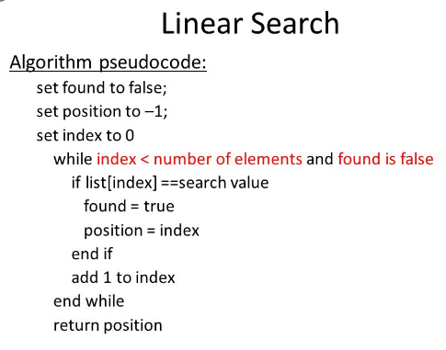
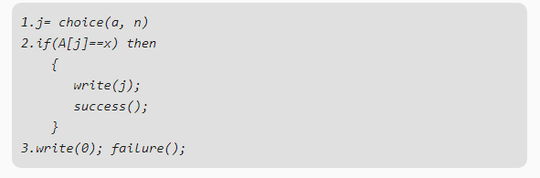
Deterministic VS Non. Deterministic

Slide 26
R problems
R is the class of decision problems solvable by a Turing machine.

Slide 27
P and NP
Big-O allowed us to group algorithms by run-time
Today, we’re talking about sets of problems grouped by how easy they are to solve
NP
P

Slide 28
NP-Complete problems
NP is the set of problems that can be verified in polynomial time
A problem can be verified in polynomial time if you can check that a given solution is correct in polynomial time
NP-Complete Problems
A problem is NP-complete if:
it can be verified in polynomial time (i.e. in NP)
any NP-complete problem can be reduced to the problem in polynomial time
Travelling salesperson problem is NP-complete

Slide 29
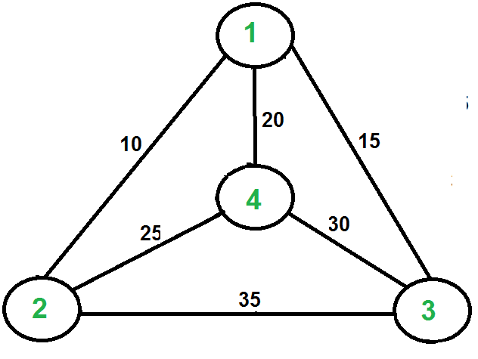
Travelling salesperson Problem
Travelling Salesman Problem (TSP): Given a set of cities and distance between every pair of cities, the problem is to find the shortest possible route that visits every city exactly once and returns to the starting point.

Slide 30
Recursive solution
Naive Solution: 1) Consider city 1 as the starting and ending point. 2) Generate all (n-1)! Permutations of cities. 3) Calculate cost of every permutation and keep track of minimum cost permutation. 4) Return the permutation with minimum cost.
Time Complexity: Θ(n!)

Slide 31
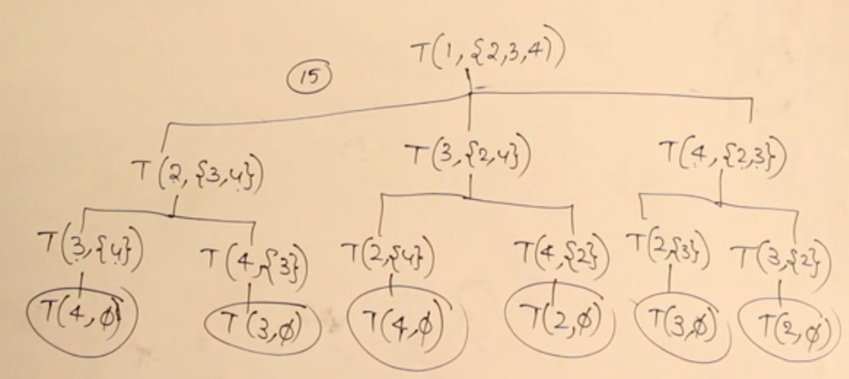
Dynamic Programming Solution

